Slide 1
Introduction to MATLAB and image processing
Amin Allalou
amin@cb.uu.se
Centre for Image Analysis
Uppsala University
Computer Assisted Image Analysis
April 4 2008

Slide 2
MATLAB and images
The help in MATLAB is very good, use it!
An image in MATLAB is treated as a matrix
Every pixel is a matrix element
All the operators in MATLAB defined on
matrices can be used on images: +, -, *, /, ^, sqrt, sin, cos etc.

Slide 3
Images in MATLAB
MATLAB can import/export several image formats
  BMP (Microsoft Windows Bitmap)
  GIF (Graphics Interchange Files)
  HDF (Hierarchical Data Format)
  JPEG (Joint Photographic Experts Group)
  PCX (Paintbrush)
  PNG (Portable Network Graphics)
  TIFF (Tagged Image File Format)
  XWD (X Window Dump)
  MATLAB can also load raw-data or other types of image data
Data types in MATLAB
  Double (64-bit double-precision floating point)
  Single (32-bit single-precision floating point)
  Int32 (32-bit signed integer)
  Int16 (16-bit signed integer)
  Int8 (8-bit signed integer)
  Uint32 (32-bit unsigned integer)
  Uint16 (16-bit unsigned integer)
  Uint8 (8-bit unsigned integer)

Slide 4
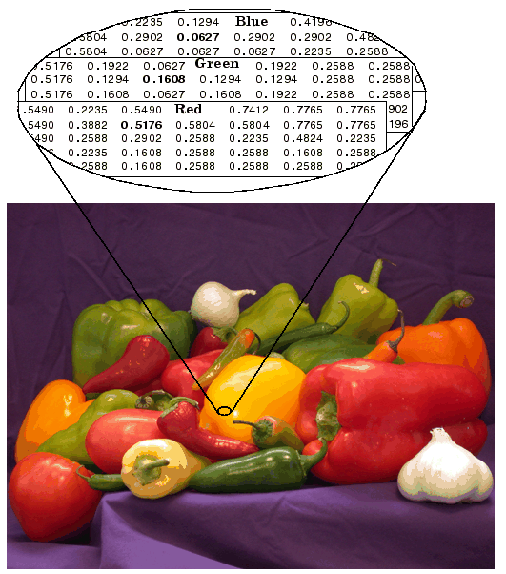
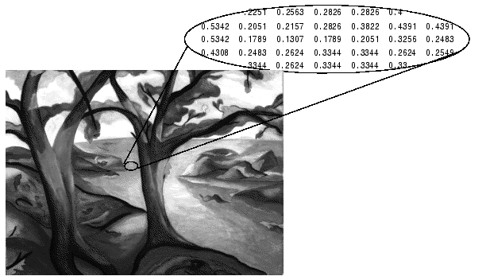
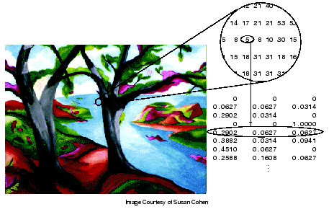
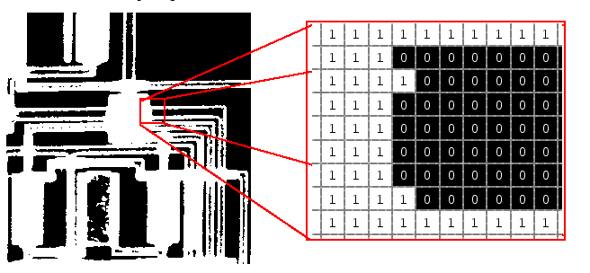
Images in MATLAB
• Binary images : {0,1}
• Intensity images : [0,1] or uint8, double etc.
• RGB images : m-by-n-by-3
• Indexed images : m-by-3 color map
• Multidimensional images m-by-n-by-p (p is the number of layers)

Slide 5
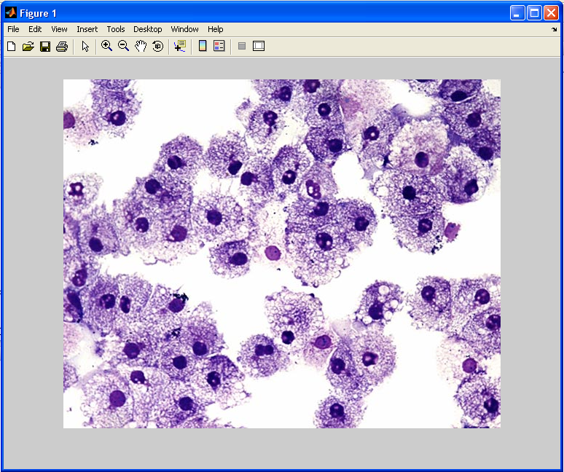
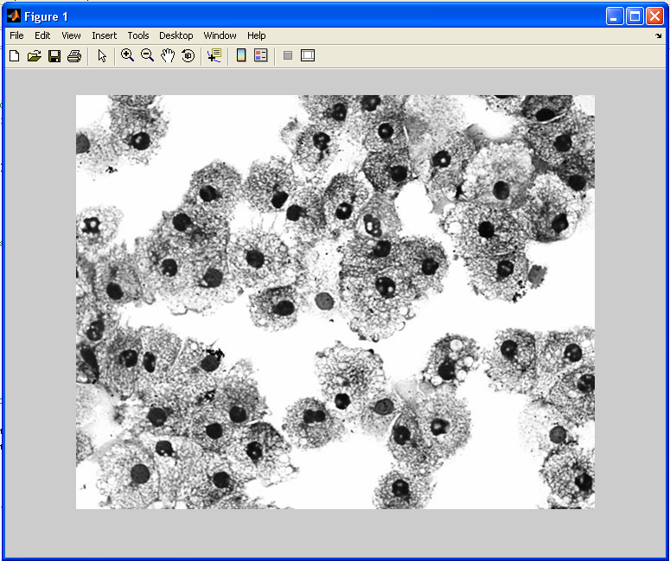
Image import and export
Read and write images in Matlab
>> I=imread('cells.jpg');
>> imshow(I)
>> size(I)
ans = 479 600 3 (RGB image)
>> Igrey=rgb2gray(I);
>> imshow(Igrey)
>> imwrite(lgrey, 'cell_gray.tif', 'tiff')
Alternatives to imshow
>>imagesc(I)
>>imtool(I)
>>image(I)

Slide 6

Images and Matrices
How to build a matrix (or image)?
>> A = [ 1 2 3; 4 5 6; 7 8 9 ];
A = 1 2 3
4 5 6
7 8 9
>> B = zeros(3,3)
B = 0 0 0
0 0 0
0 0 0
>> C = ones(3,3)
C = 1 1 1
1 1 1
1 1 1
>>imshow(A) (imshow(A,[]) to get automatic pixel range)

Slide 7
Images and Matrices
Accesing image elements (row, column)
>> A(2,1)
ans = 4
: can be used to extract a whole column or row
>> A(:,2)
ans =
2
5
8
or a part of a column or row
>> A(1:2,2)
ans =
2
5
X
Y
A =
2 3
5 6
7 8 9

Slide 8
Image Arithmetic
Arithmetic operations such as addition, subtraction, multiplication and division can be applied to images in MATLAB
  +, -, *, / performs matrix operations
>> A+A
ans = 2 4 6
8 10 12
14 16 18
>> A*A
ans = 30 36 42
66 81 96
102 126 150
To perform an elementwise operation use . (.*, ./, .*, .^ etc)
>> A.*A
ans = 1 4 9
16 25 36
49 64 81
A =
2 3
5 6
7 8 9

Slide 9
Logical Conditions
equal (==) , less than and greater than (< and >), not equal (~=) and not (~)
find(‘condition’) - Returns indexes of A’s elements that satisfies the condition.
>> [row col]=find(A==7)
row = 3
col = 1
>> [row col]=find(A>7)
row = 3
3
col = 2
3
>> Indx=find(A<5)
Indx = 1
2
4
7
A =
2 3
5 6
7 8 9

Slide 10
Flow Control
Flow control in MATLAB
- if, else and elseif statements
(row=1,2,3 col=1,2,3)
if row==col
A(row, col)=1;
elseif abs(row-col)==1
A(row, col)=2;
else
A(row, col)=0;
end
A =
1 2 0
2 1 2
0 2 1

Slide 11

Flow Control
Flow control in MATLAB
- for loops
for row=1:3
for col=1:3
if row==col
A(row, col)=1;
elseif abs(row-col)==1
A(row, col)=2;
else
A(row, col)=0;
end
end
end
A =
1 2 0
2 1 2
0 2 1

Slide 12
Flow Control
while, expression, statements, end
Indx=1;
while A(Indx)<6
  A(Indx)=0;
  Indx=Indx+1;
  end
A =
2 3
5 6
7 8 9
A =
0 2 3
0 5 6
7 8 9

Slide 13
Working with M-Files
M-files can be scripts that simply execute a series of MATLAB statements, or they can be functions that also accept input arguments and produce output.
MATLAB functions:
  Are useful for extending the MATLAB language for your application.
  Can accept input arguments and return output arguments.
  Store variables in a workspace internal to the function.

Slide 14
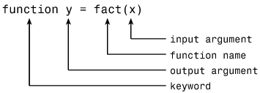
Working with M-Files
Create a new empty m-file
function B=test(I)
[row col]=size(I)
for r=1:row
for c=1:col
if r==c
A(r, c)=1;
elseif abs(r-c)==1
A(r, c)=2;
else
A(r, c)=0;
end
end
end
B=A;

